Slide 1

Air Qualifiers
Alana Adams, Sharada Muthusubramanian, Chris Finklea

Slide 2



Team Air Qualifiers
API source - OpenAQ.
Data: Air quality attributes
CEO
CFO
CIO
Chris Finklea
Alana Adams
Sharada Muthu

Slide 3
Overview
Team Air Qualifiers are analyzing to understand the air quality across North America (i.e. US, CA, MX)
API: https://api.openaq.org/v2/measurements
https://api.openaq.org/v2/countries
https://api.openaq.org/v2/parameters
https://api.openaq.org/v2/locations

Slide 4
Goal and Delivered
Goal
Delivered
Identify a data source to do our project:
We leveraged OpenAQ api to get our data
Air quality in North America - API data extraction from: OpenAQ
Started with 10,000+ observation and narrowed our data 883 observations
Data cleansing performed leveraging
Python, MongoDB and JavaScript
Leaflet map, barchart, ERD diagram, scatter plot and analysis on the data
1
3
Discover patterns in air quality in North America.
2

Slide 5
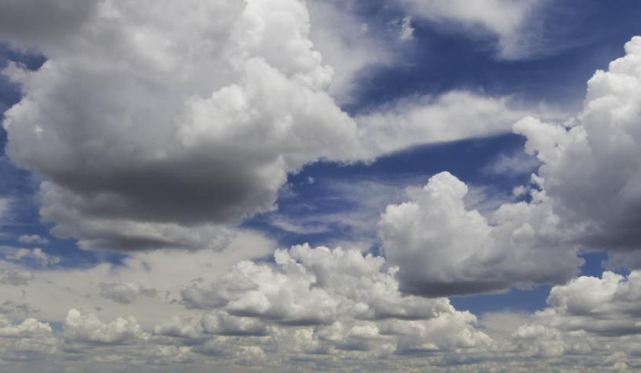
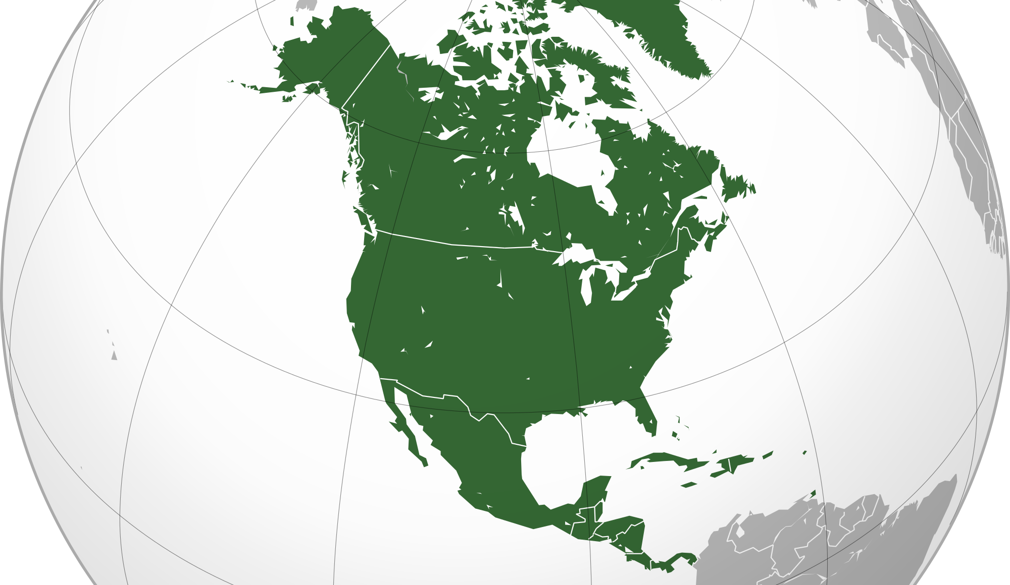
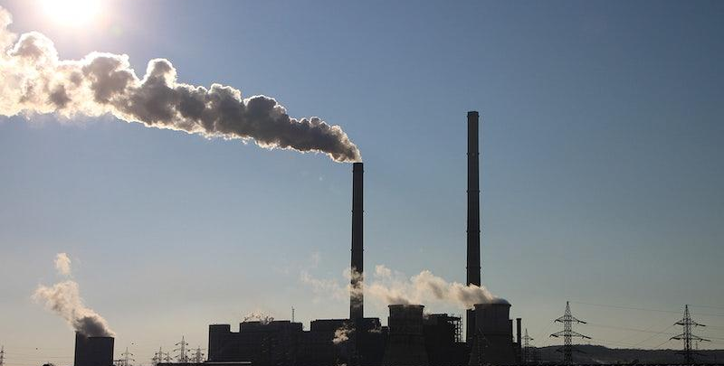
Process
Discover patterns in air quality in North America
Delivered
Identify a data source for project 3:
01
Research performed on relationships between air quality, weather, and population. We will display our findings with heat maps, bar charts, and scatter plots
03
Air quality in in North America - API data extraction from: OpenAQ
Data cleansing performed leveraging Python, PostgreSQL and JavaScript. Plotly, Geojson…
Heat map, barchart, ERD diagram, scatter plot and analysis on the data
02
Leveraged OpenAQ api to get our data

Slide 6
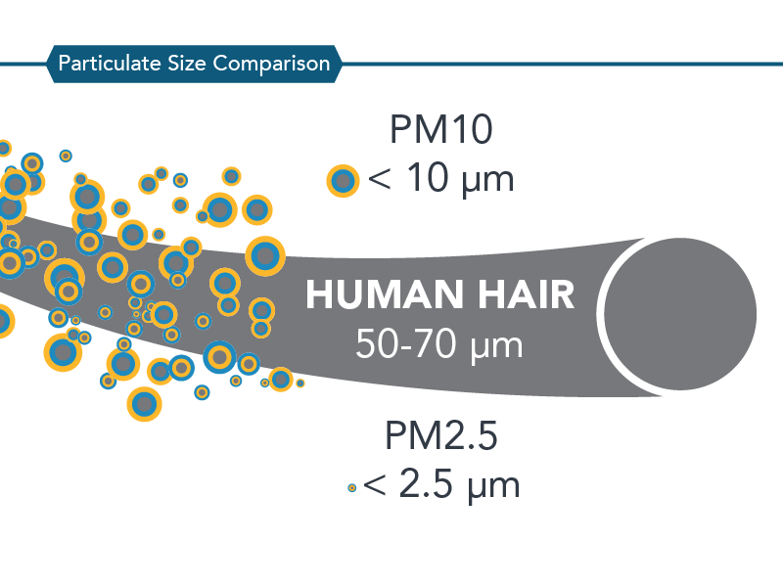
Airborne Particulates
From <https://ww2.arb.ca.gov/resources/inhalable-particulate-matter-and-health> PM is particulate matter
PM10 is particulate matter less than 10 micrometers in diameter
PM25 is particulate matter less than 2.5 micrometers in diameter
Particulate matter may be formed in the atmosphere through chemical reactions from gasses such as sulfur dioxide (SO2), nitrogen oxides (NOX), and certain organic compounds.
PM25 usually emitted by:
Combustion of gasoline, oil, diesel fuel or wood
PM10 additionally emitted by:
natural sources:
trees and vegetation,
pollen and fragments of bacteria.
man-made sources:
dust from construction sites, landfills and agriculture,
wildfires and brush/waste burning,
industrial sources,
wind-blown dust from open lands,
Notes:
Image and data source: <https://ww2.arb.ca.gov/resources/inhalable-particulate-matter-and-health>

Slide 7
Harmful Effects Caused by Particulate Matter
PM2.5, short-term exposures (up to 24-hours duration) have been associated with
premature mortality,
increased hospital admissions for heart or lung causes,
acute and chronic bronchitis,
asthma attacks,
emergency room visits,
respiratory symptoms, and
restricted activity days.
Long-term (months to years) exposure to PM2.5 has been linked to
premature death, particularly in people who have chronic heart or lung diseases, and
reduced lung function growth in children.
PM10 short-term exposures have been associated primarily with
worsening of respiratory diseases,
including asthma and chronic obstructive pulmonary disease (COPD),
leading to hospitalization and emergency department visits.
Long-term exposure to PM10 are less clear, although several studies suggest a link between long-term PM10 exposure and respiratory mortality.
The International Agency for Research on Cancer (IARC) published a review in 2015 that concluded that particulate matter in outdoor air pollution causes lung cancer.
From <https://ww2.arb.ca.gov/resources/inhalable-particulate-matter-and-health>
Notes:
Image and data source: <https://ww2.arb.ca.gov/resources/inhalable-particulate-matter-and-health>

Slide 8
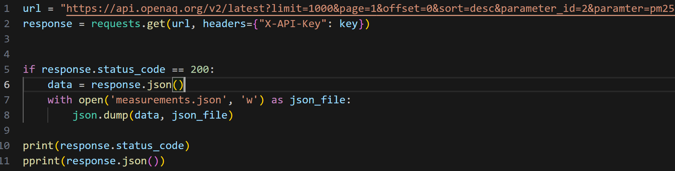
API to CSV Pipeline
Pull data from OpenAQ api
Filter for countries
Dropped less value add columns
Organize the data for ease of use
Convert dataframe to CSV with pandas
Notes:
Dropped: isMobile, city, sensorType, manufacturers etc
Organized: Split coordinates

Slide 9
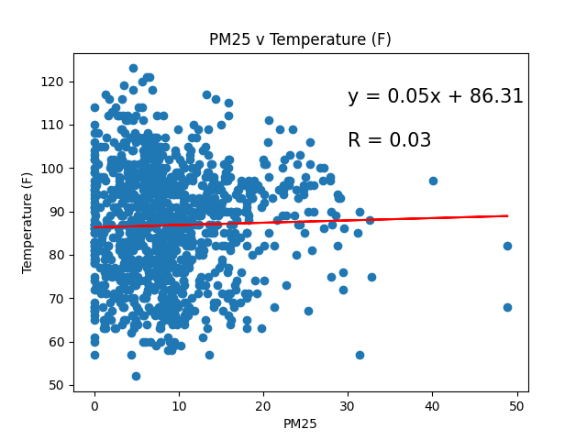
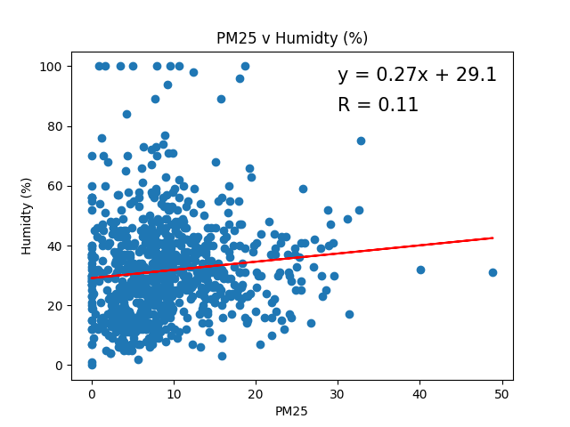
Weather Conditions and Air Quality
Notes:
Scatter plots and what they mean

Slide 10
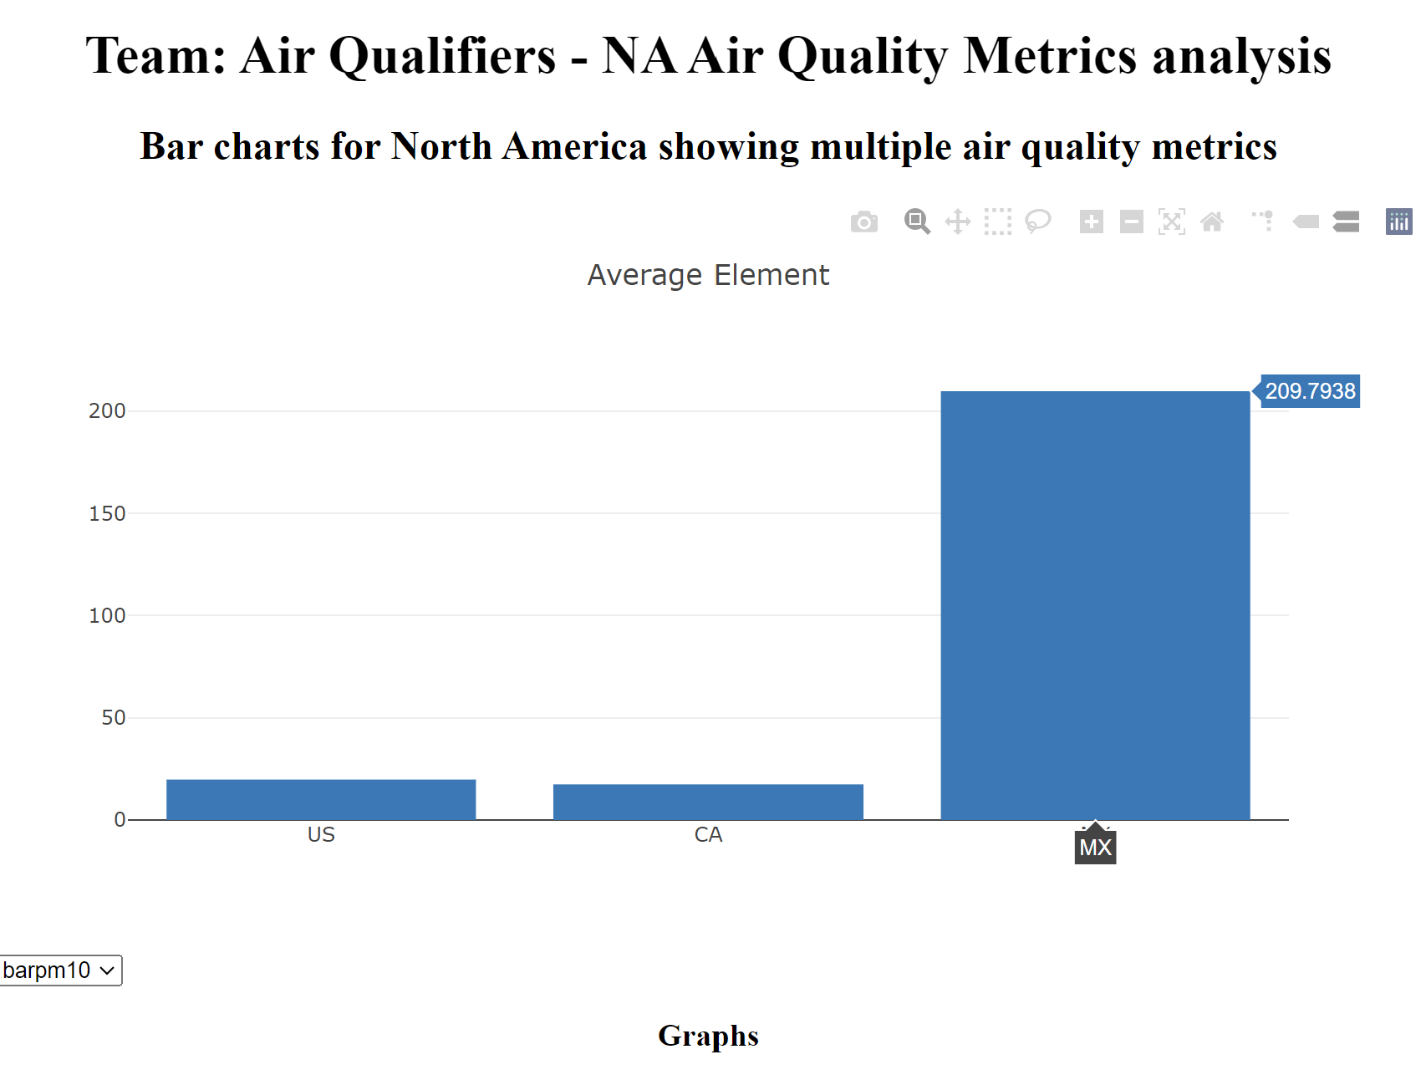
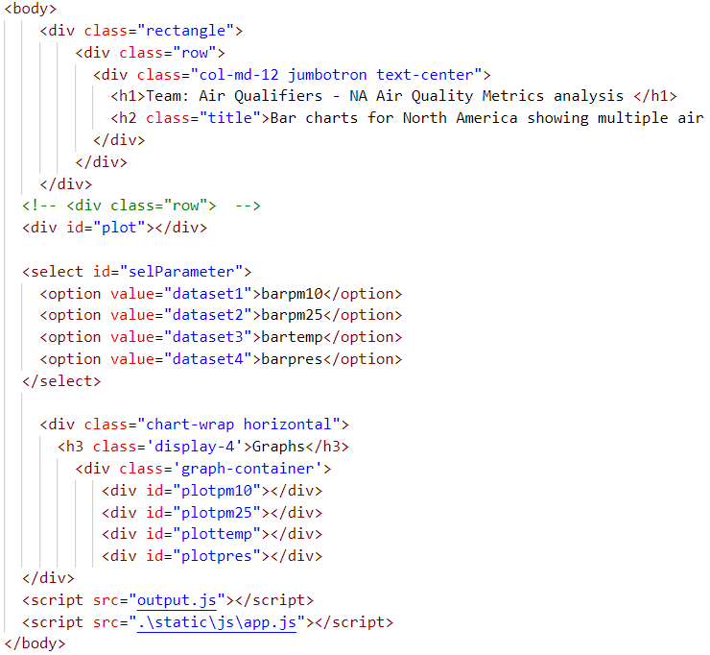
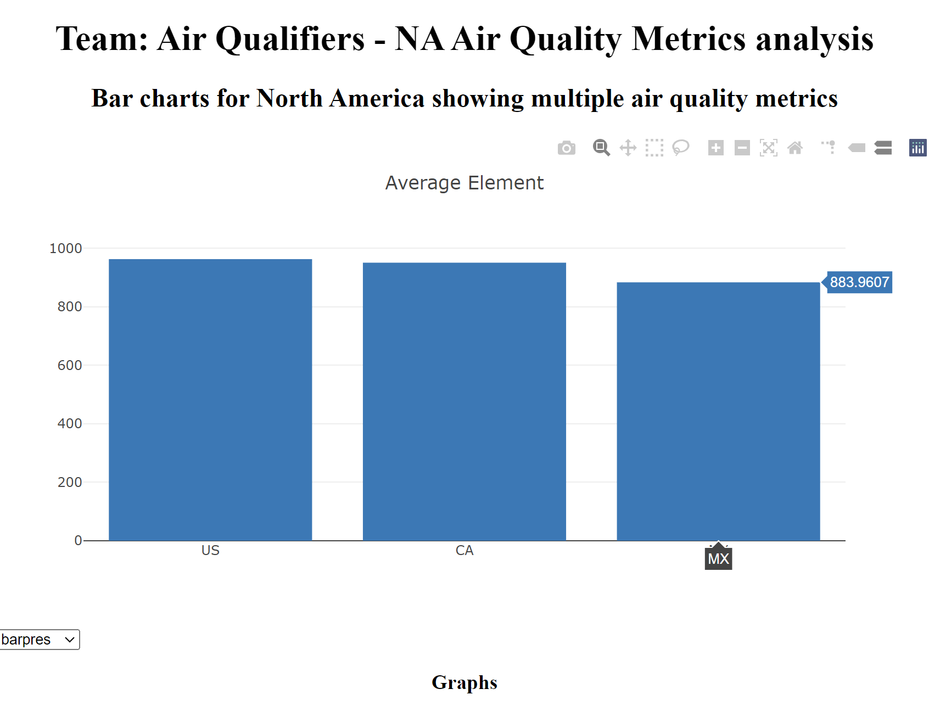
Plotly Plot
Mechanics: Created map applying filter and map reduce logic.
Analysis: Observed that pm25 and pm10 particles are at very high level in atmosphere for Mexico. We believe it is due to an outlier in MX

Slide 11
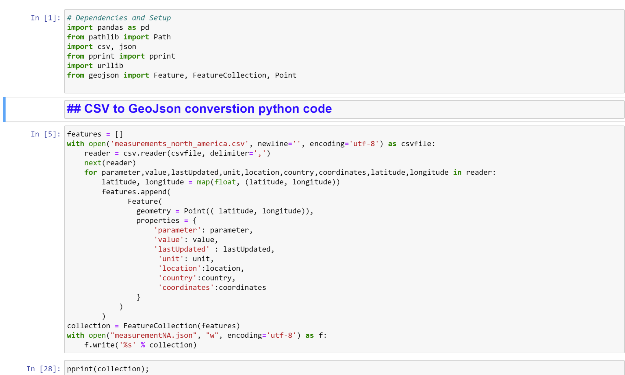
Data conversion for geojson map

Slide 12
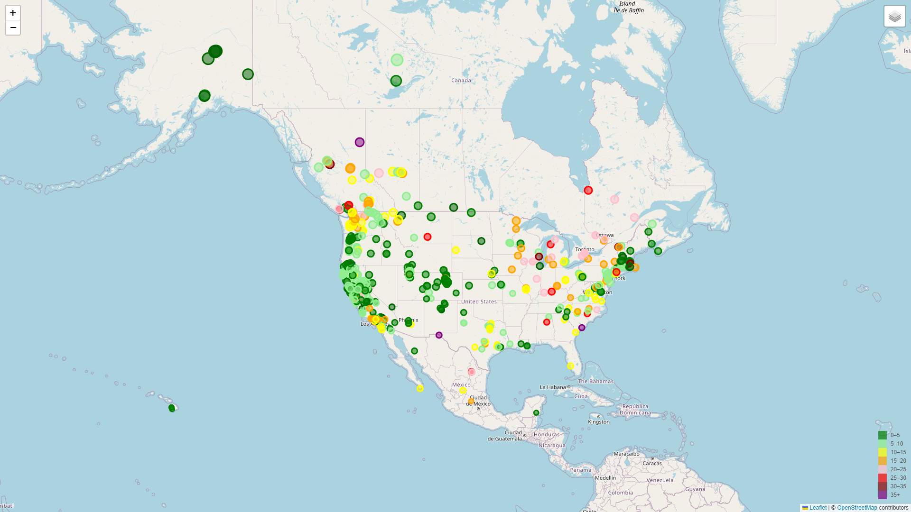
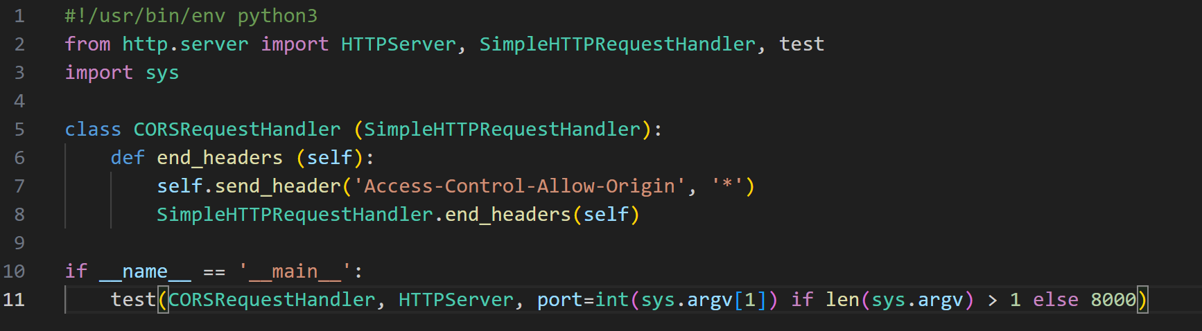
Geojson-Map displaying pm25 particles in atmosphere by country
Challenges in creating the map:
Process was looking to create map leveraging local file
We had to overcome the CORS error by importing HTTP server with CORS request handler
Map analysis:
East coast had some higher levels of pm25 (pink circles)
There was one location in Mexico that had 3000+pm level (we believe it is data issue and outlier)
Overall all countries (provided if the outlier was removed) had low pm25 levels
Notes:
Add map, local host code, mention outlier and density of data per country

Slide 13
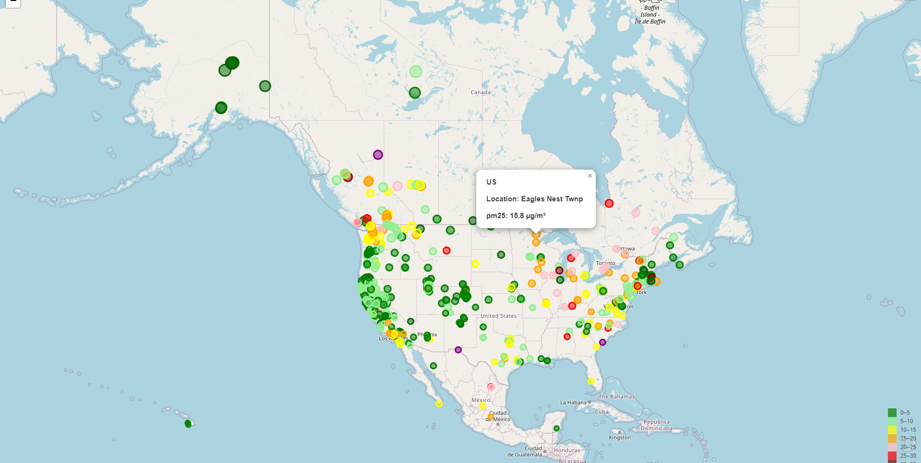
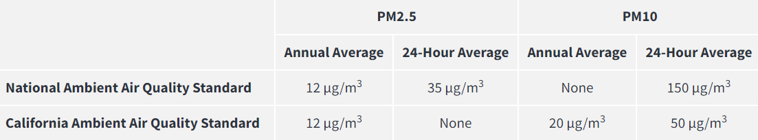
Air Quality Standards
Across North America
Notes:
Data and Image Source <https://ww2.arb.ca.gov/resources/inhalable-particulate-matter-and-health>

Slide 14
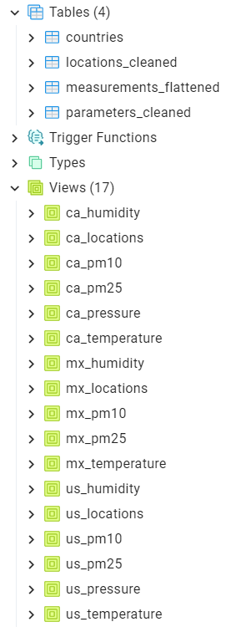
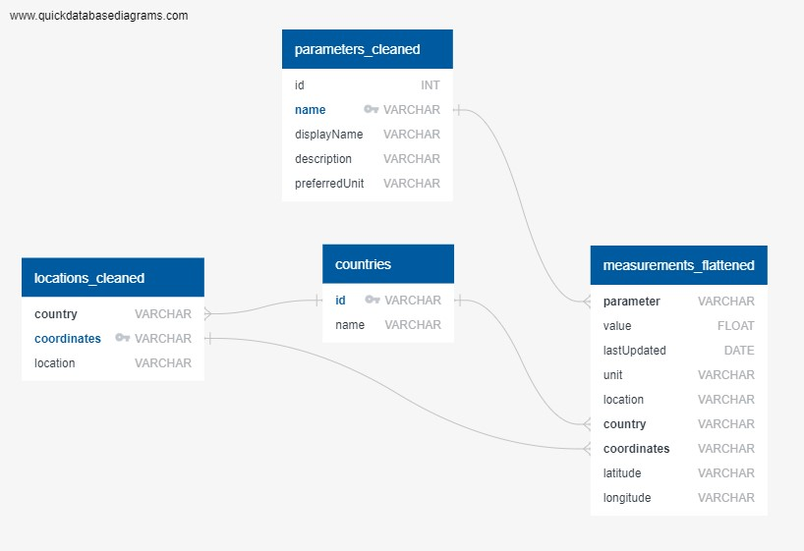
PostgreSQL and Database Creation

Slide 15
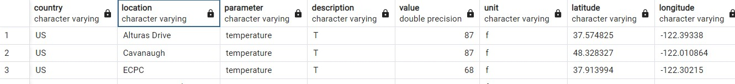
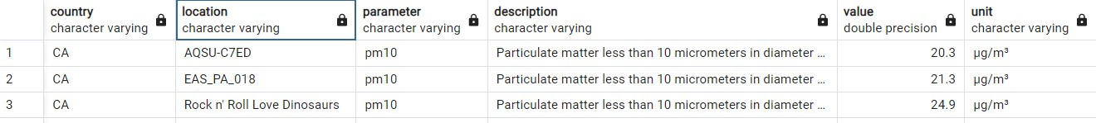
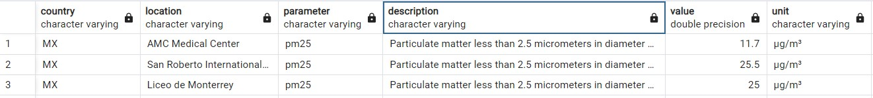
PostgreSQL and Database Creation

Slide 16
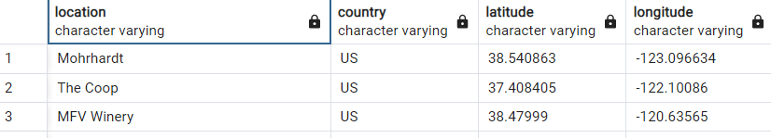
PostgreSQL and Database Creation

Slide 17
Challenges with reading data in java
Universal issues with Java
Resolution
JavaScript not being able read the data objects to pass to geojson
CORS error
Data formats to read local files needed to have a js file format for passing parameters to create plotly charts
Not being able to dynamically update custom chart titles.
Leveraged python to convert CSV file to Geojson file
Localhost modification
Converted CSV to JS file to pass the parameter to barchart as local file
Implemented generic title to over come dynamic title

Slide 18
Thank you.

